Slide 1

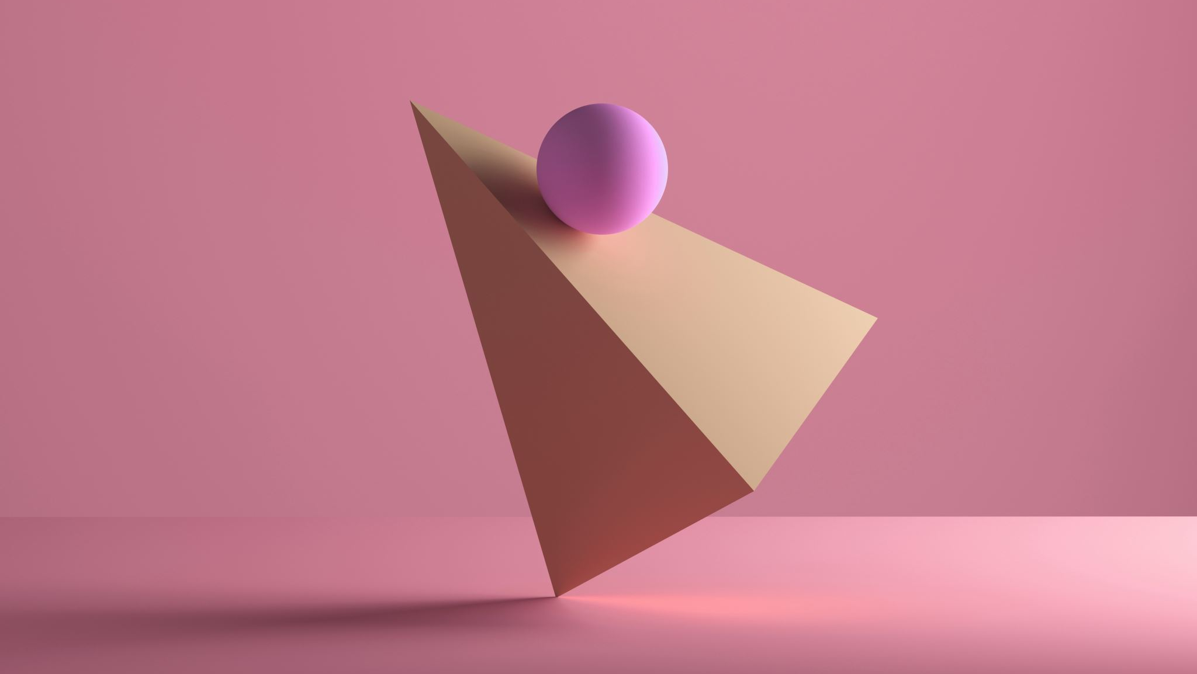
Introduction to Artificial Intelligence
A Comparative Study of Checker Games,
Implementing Alpha-Beta-Pruning Minmax Search
(Time Complexity, Efficiency and Accuracy)
Presented by:
Olusola Onawoga

Slide 2
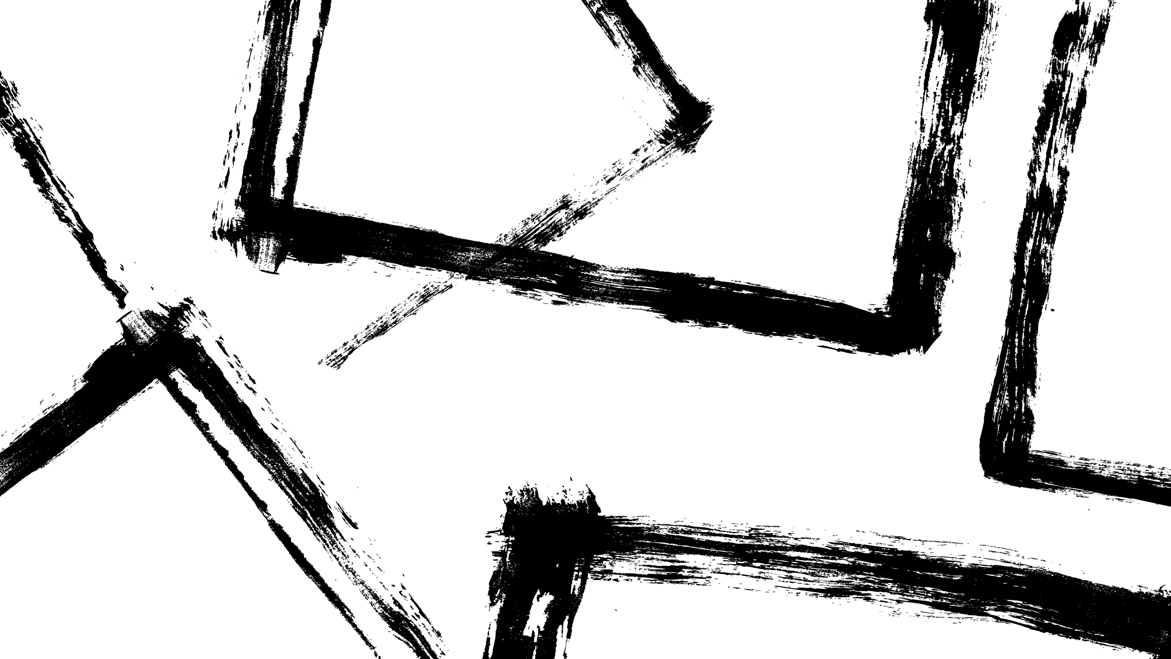

Project Objectives
Deliverables
Approach: Tools &Techniques
Evaluation Methodology
2

Slide 3
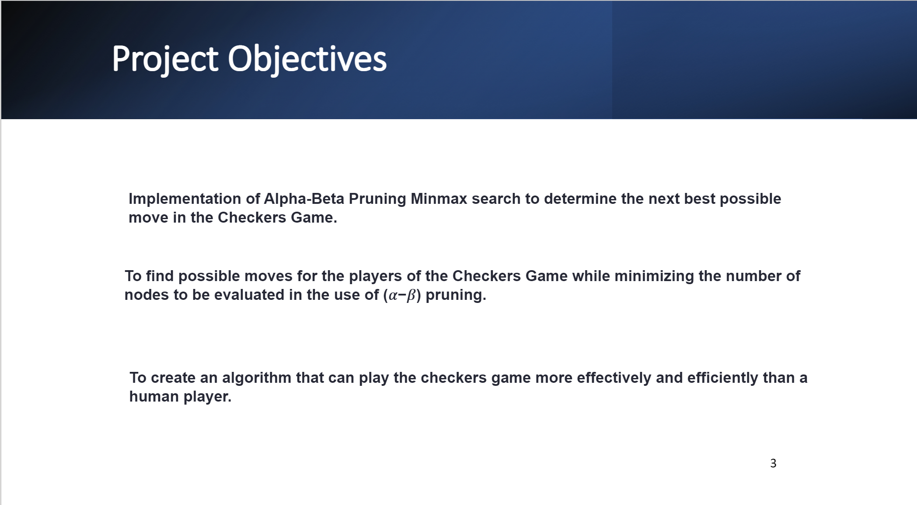

Slide 4


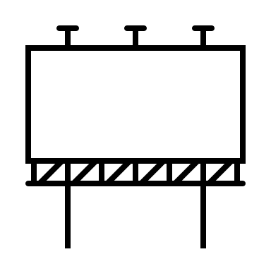
Deliverables
Source code for the Checkers Game
Output of the Checkers Game with the AI agent determining the best possible moves for each piece entered by the individual players
The deliverables will be submitted in the form of a project report, which will include the source code, the GUI, the AI agent implementation, and the user manual. The presentation will also include an overview of the project, a description of the approach used to develop the game and AI agent, and the evaluation methodology used to test the game and the AI agent.
Project Presentation
4

Slide 5
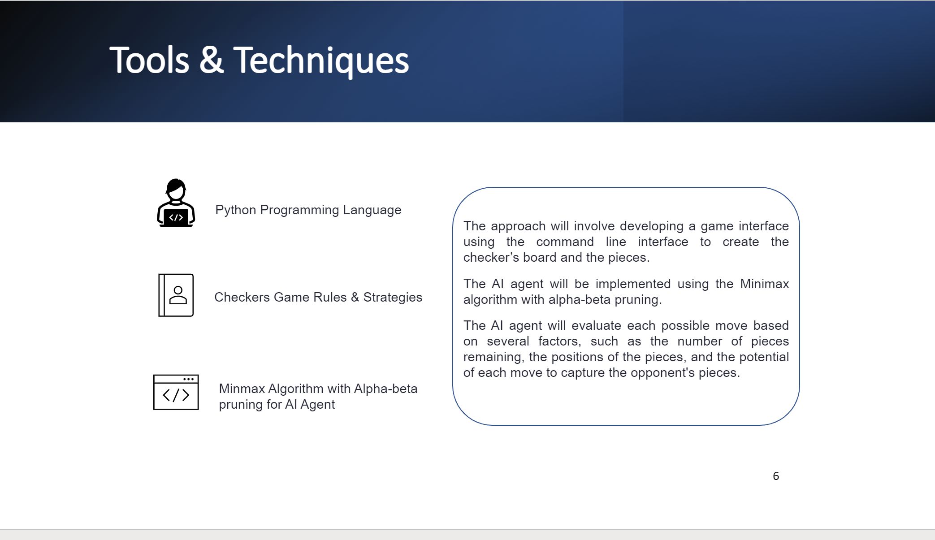

Slide 6

Checker Board (8x8)
'🟫', '🆖', '🟫', '🆖', '🟫', '🆖', '🟫', '🆖'],
['🆖', '🟫', '🆖', '🟫', '🆖', '🟫', '🆖', '🟫'],
['🟫', '🆖', '🟫', '🆖', '🟫', '🆖', '🟫', '🆖'],
['🟫', '🟫', '🟫', '🟫', '🟫', '🟫', '🟫', '🟫'],
['🟫', '🟫', '🟫', '🟫', '🟫', '🟫', '🟫', '🟫'],
['🆗', '🟫', '🆗', '🟫', '🆗', '🟫', '🆗', '🟫'],
['🟫', '🆗', '🟫', '🆗', '🟫', '🆗', '🟫', '🆗'],
['🆗', '🟫', '🆗', '🟫', '🆗', '🟫', '🆗', '🟫'],

Slide 7
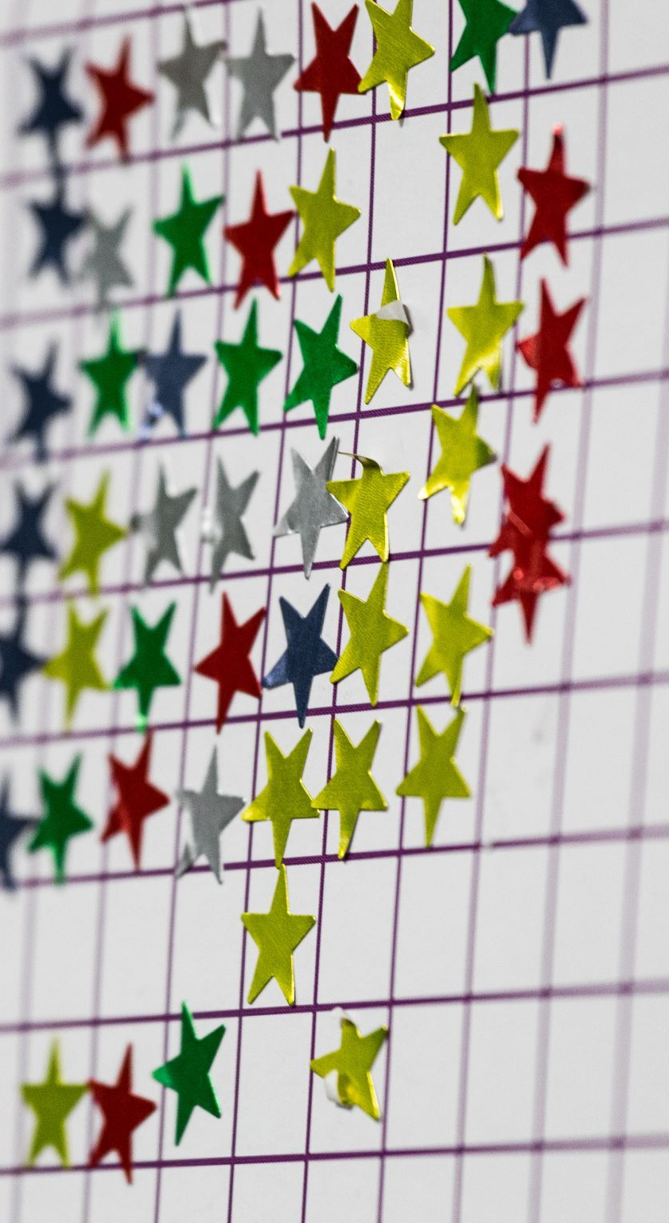
How to Build the Code ​
Board Setup
First, create a 2-dimensional list to represent the 8x8 checkerboard. Assign each square's value to zero.
Piece Creation
Create two classes representing both types of checker pieces - black and white. Each class should have x and y coordinates, a value assigned to the color (e.g., black=1, white=2) and a Boolean check if it's a king or not.
Piece Placement
Create a method that places the pieces on the board. Assign the respective colors and coordinates to each piece.
Movement
Create a method that validates if a move by a given piece is legal. The move must be diagonal and can only move to an empty square. If the piece is a king, it can move diagonally in any direction.
Capture
Create a method that verifies if a player can capture an opponent's piece. A player can only capture by moving 2 squares diagonally in the same direction, jumping over an opponent's piece to an empty square.
King Up
Create a logic where a piece should become a king if it reaches the opponent's side.
Play
Implement a while loop, which checks after each player's turn if there is still a possibility to make a move. The loop should continue as long as a piece is still on the board, and there are possible moves.
Gameover
Create a method that checks if the game is over by checking if one of the players has no more active pieces. Determine the winner by whoever has more pieces left on the board. of the players has no more active pieces. Determine the winner by whoever has more pieces left on the board.

Slide 8
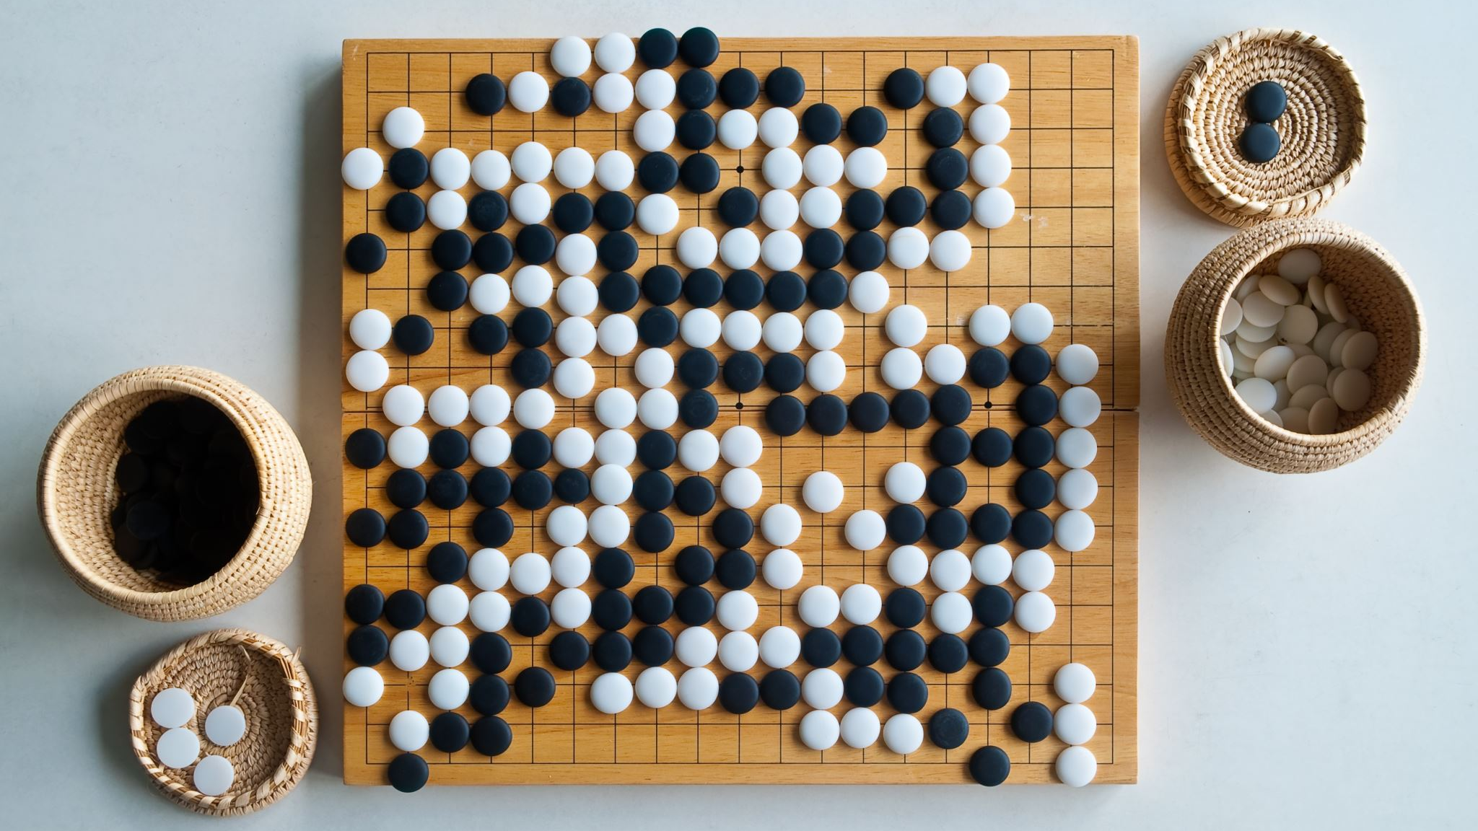
Checker Game Without Using Alpha-Beta-Pruning Minmax Search

Slide 9
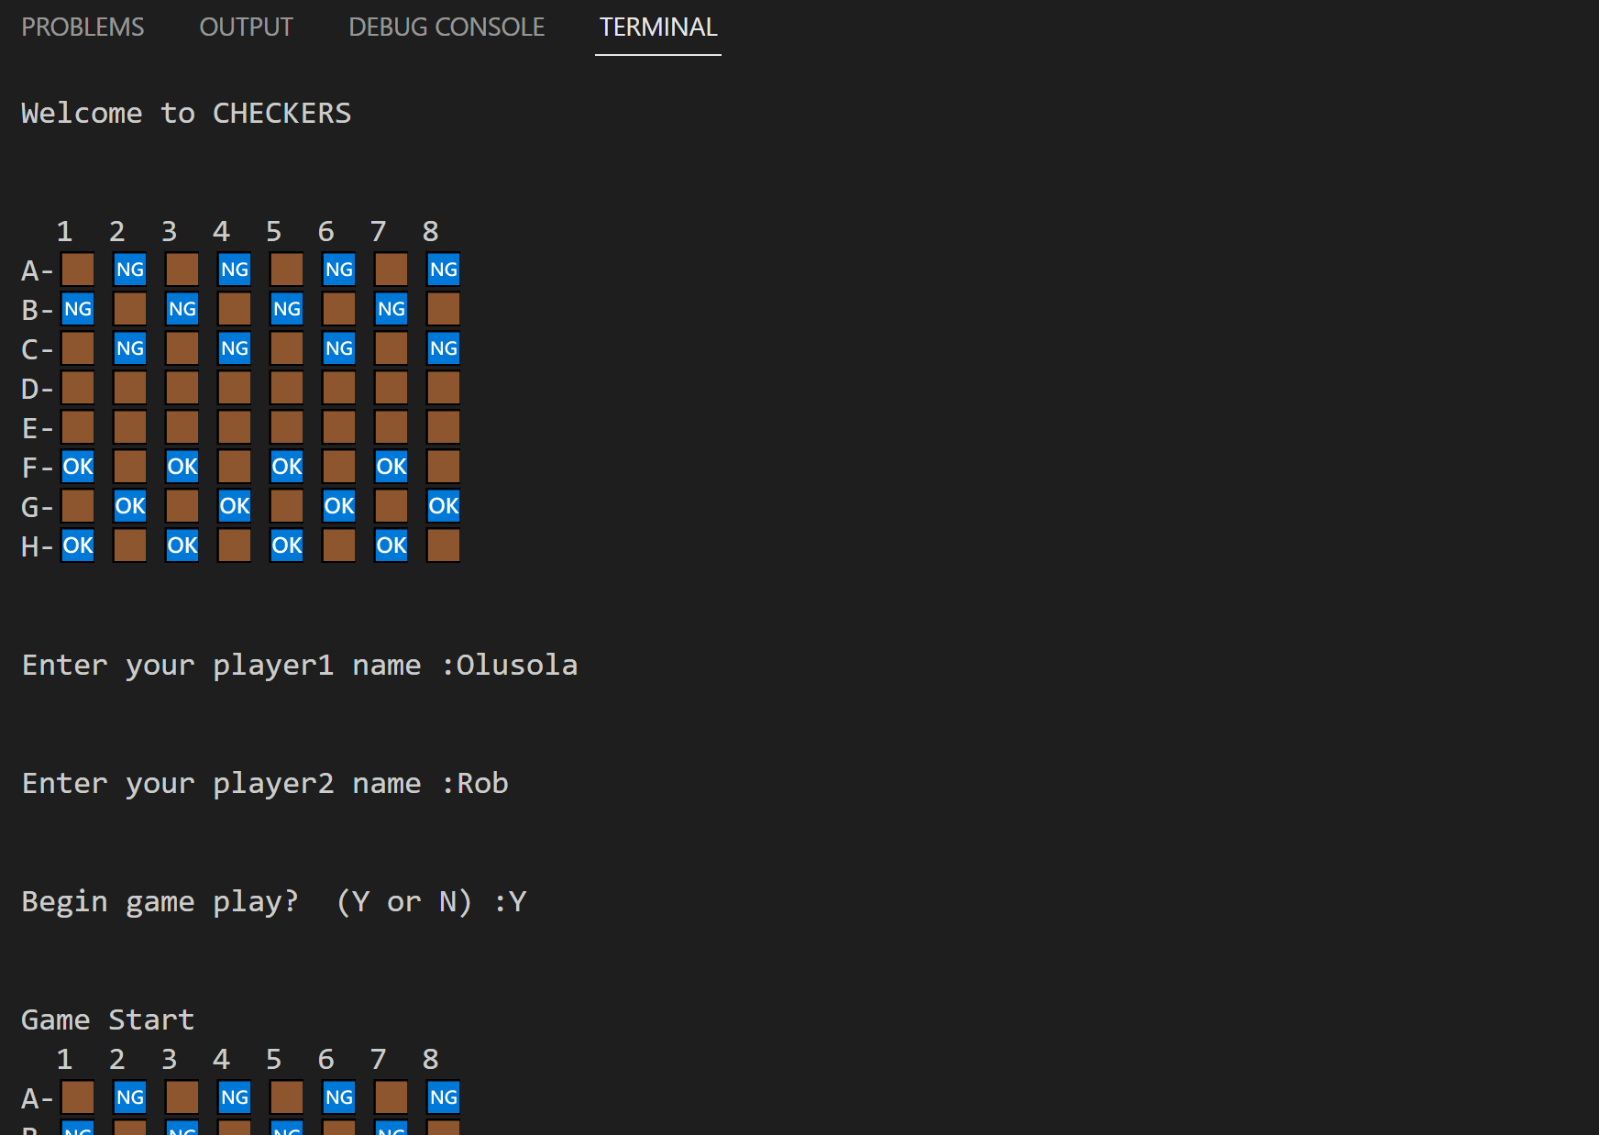
Program In Operation

Slide 10
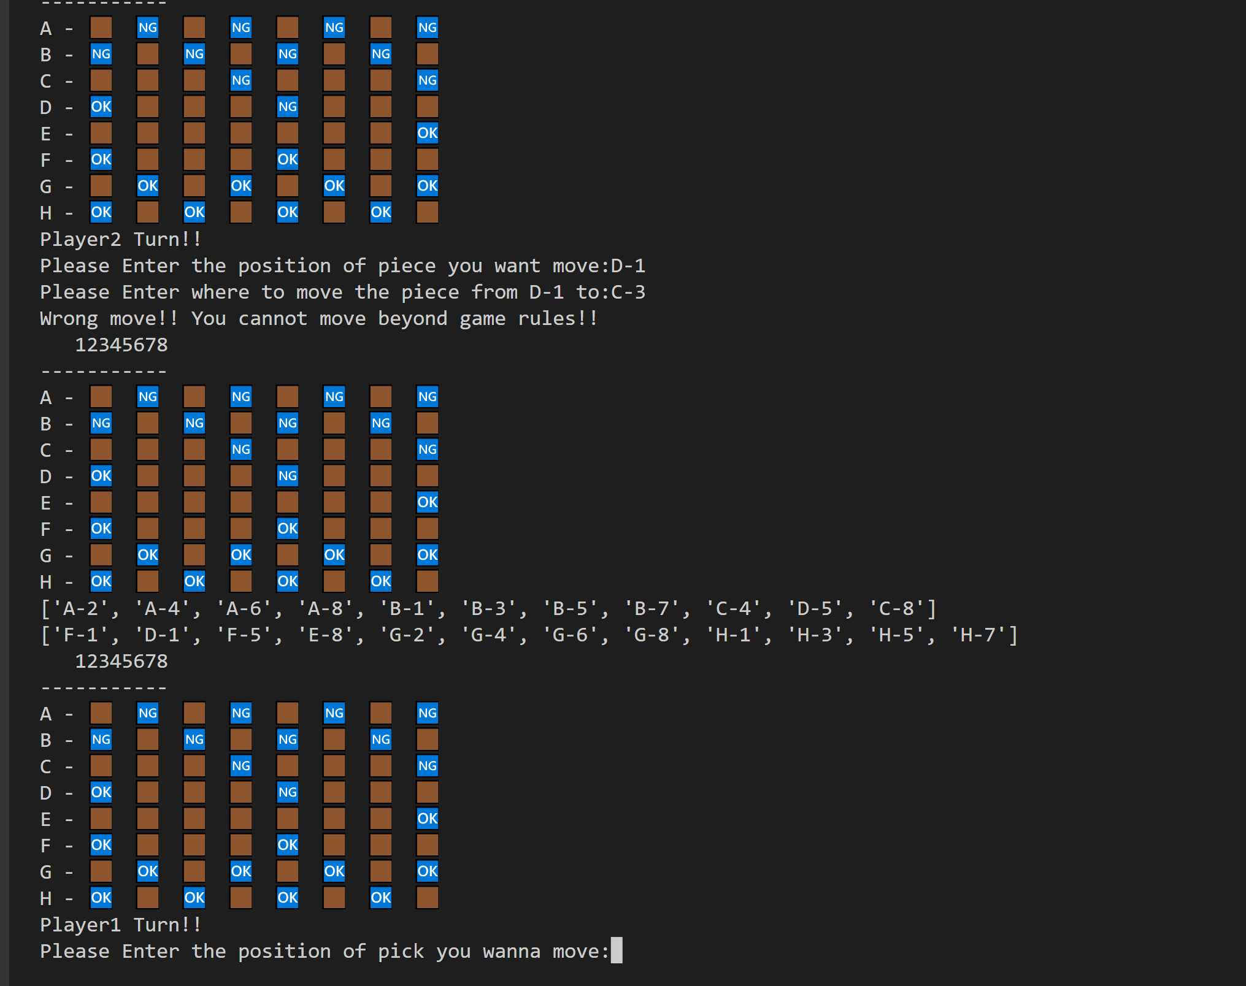
Valid and Invalid Moves Prompt

Slide 11
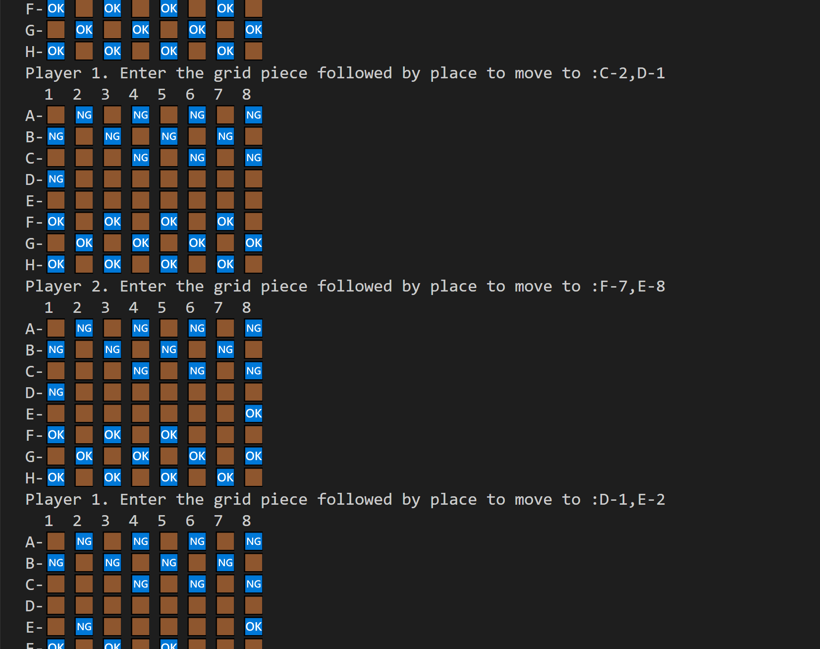
Program In Operation

Slide 12
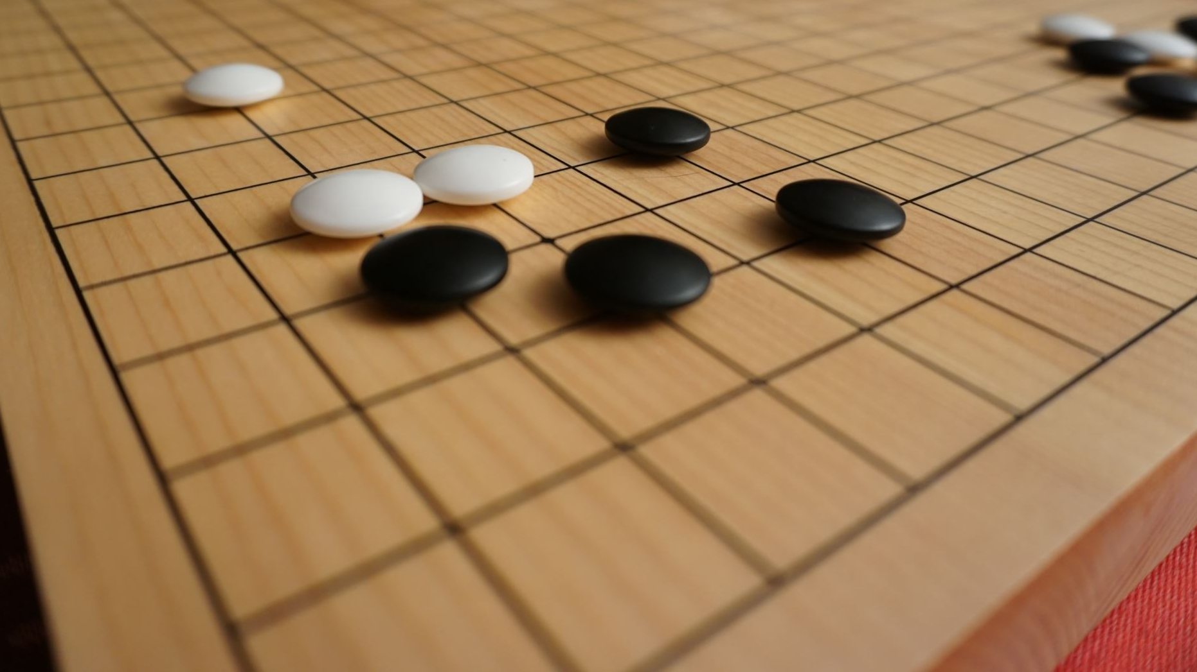
Checker Game Using Alpha-Beta-Pruning Minmax Search

Slide 13
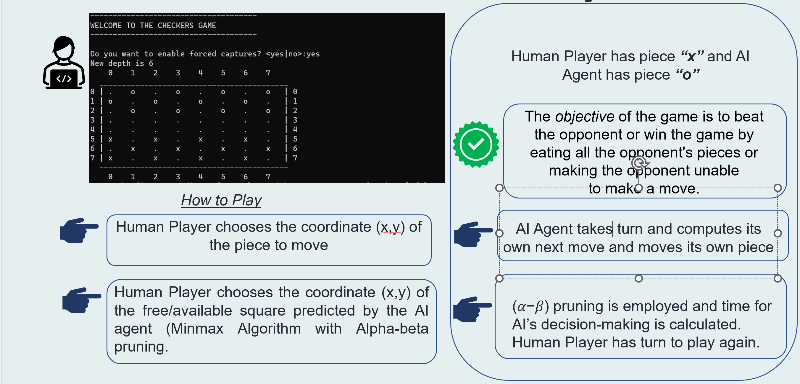
Overview of Checker Game Build Phase

Slide 14
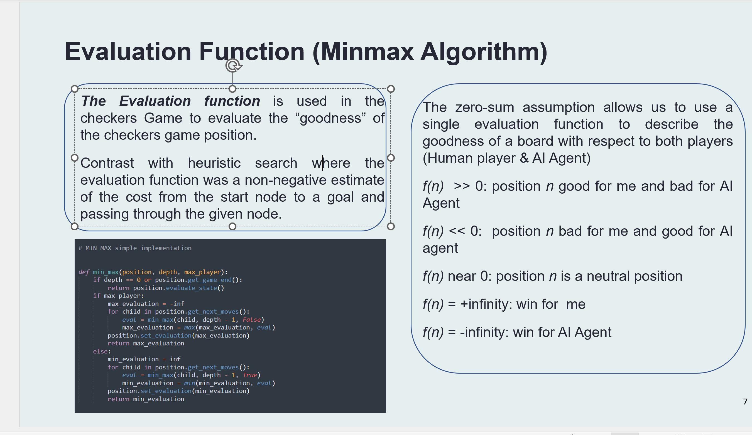

Slide 15
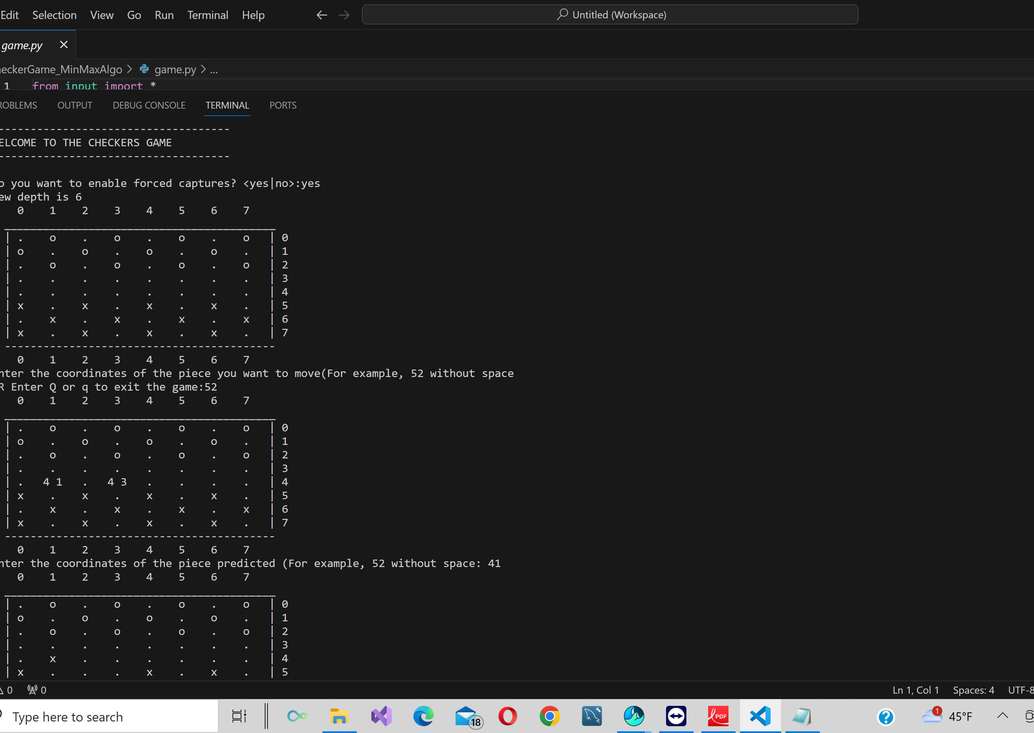
Game Running

Slide 16
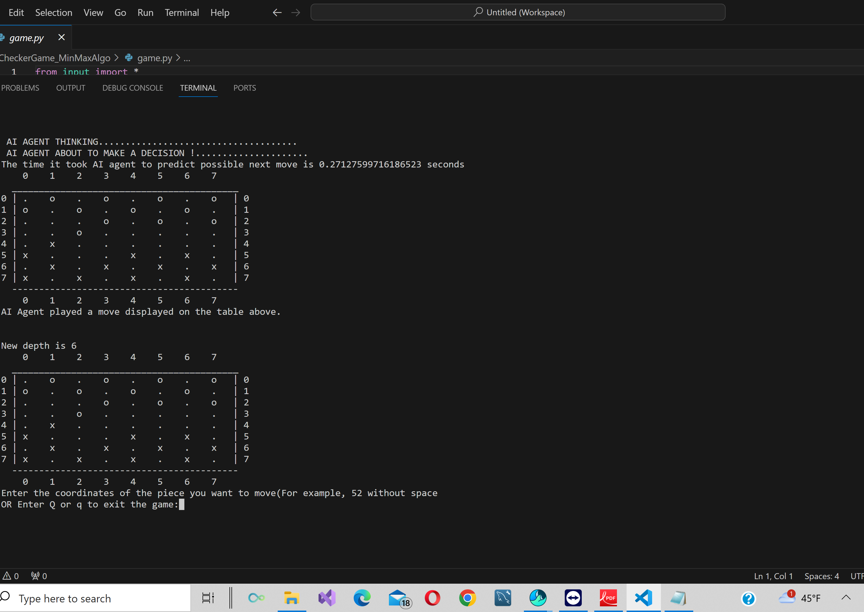
AI Predicted Time and Moves

Slide 17
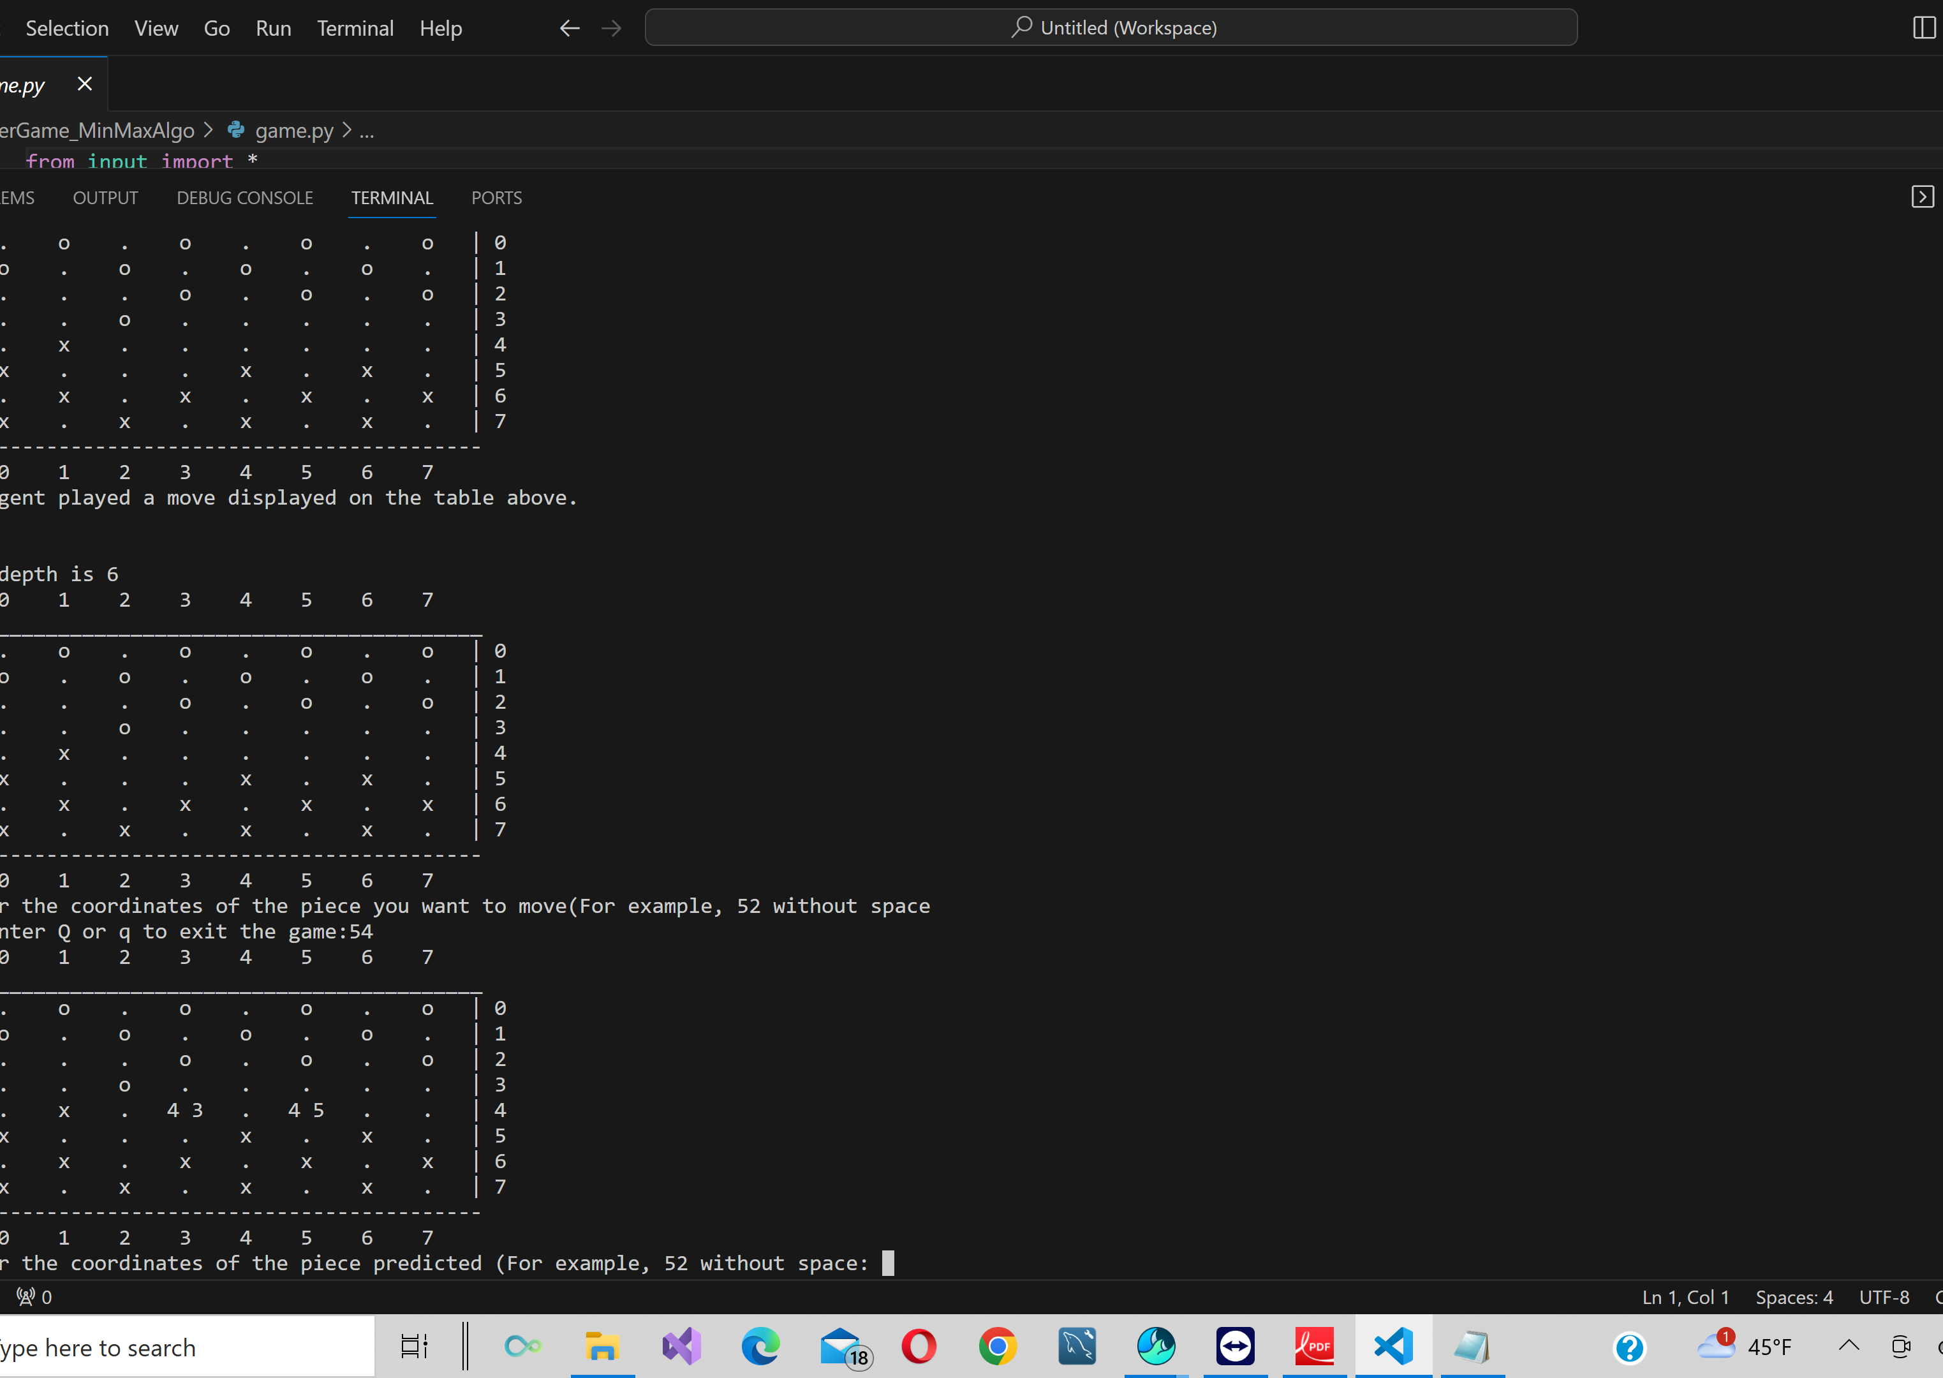
Game Ongoing Using Alph-Beta Prunning

Slide 18
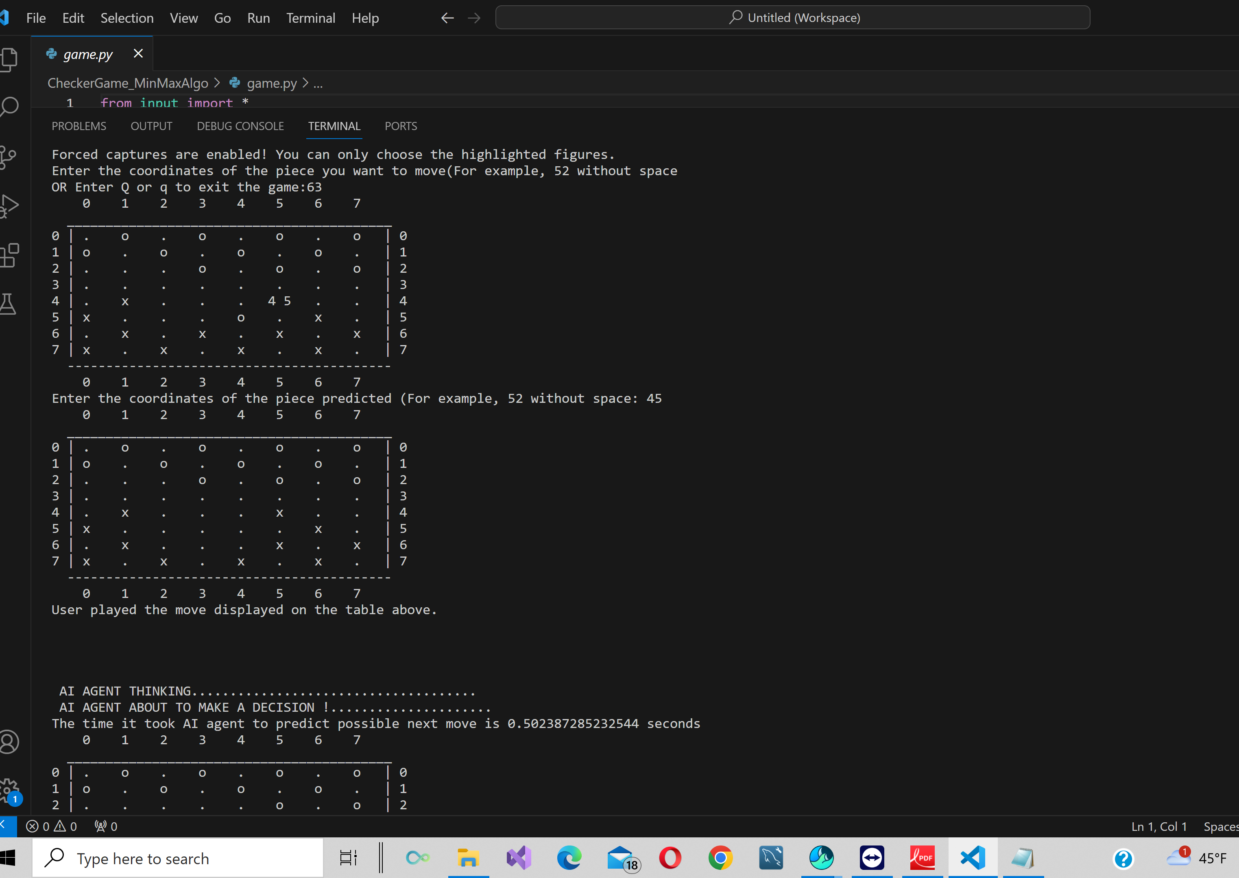

Slide 19
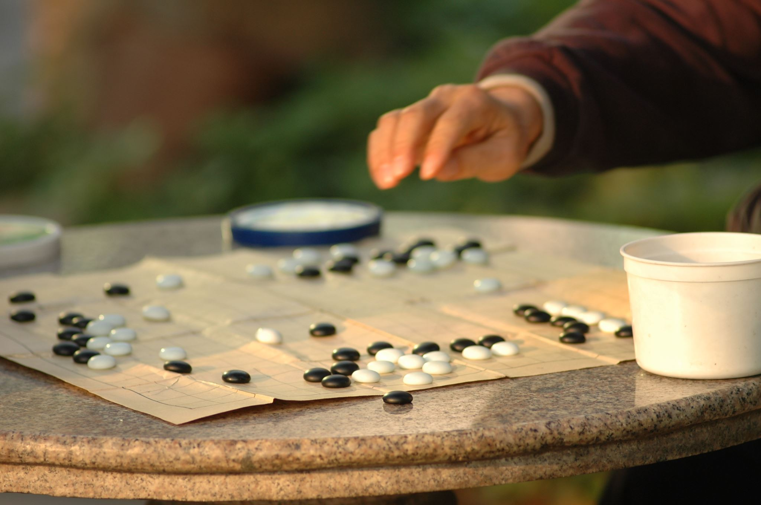
Checker Game Running Demo
DEMO

Slide 20

Evaluation Methodology
Evaluation of the Minimax algorithm with Alpha-beta pruning can be based on several factors, including:
Efficiency: The algorithm should be able to evaluate a large number of moves in a short amount of time to ensure that the AI agent is making optimal moves efficiently. The efficiency of the algorithm can be measured in terms of the average time taken by the AI agent to make a move and the number of moves it evaluates in a given time.
Accuracy: The algorithm should be able to accurately predict the opponent's next move and select the optimal move for the AI agent. The accuracy of the algorithm can be measured in terms of the number of times the AI agent wins or minimizes losses against the opponent.
Complexity of the game: Checkers is a game with a moderate level of complexity, with a relatively low branching. Hence, the Minimax algorithm with Alpha-beta pruning should be able to evaluate all possible moves in a reasonable amount of time.
Size of the search space: The search space in checkers is relatively small compared to other games, but it still requires evaluating a large number of possible moves. The Alpha-beta pruning technique can be used to reduce the size of the search space and improve the efficiency of the algorithm.

